Slide 1
Lamar University College
Web Tour
College Prep
Mr. Gordon
jgordon@bisdtx.org

Slide 2
Upcoming Events
hi

Slide 3
Lamar University Facts
Lamar University is located in Beaumont
3 hours 15 minutes east of Bastrop.
Lamar University is a public university.
Lamar’s mascot is the Cardinal.
hi

Slide 4
Lamar University Facts
Go to: https://www.lamar.edu/about-lu/index.html
and find the answers to the following questions.
1.How many students attend Lamar University?
2. How many degree programs does Lamar University offer?
3. What percentage are First Generation (they are the first in their family to attend college) students?
hi

Slide 5
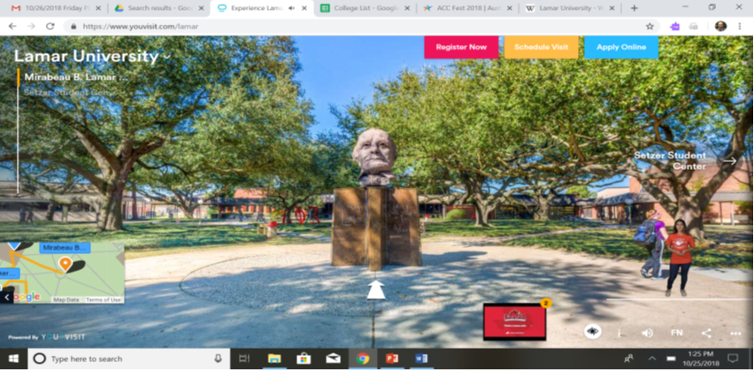
Lamar University Virtual Tour
Choose one building and take a virtual tour of the campus.
https://www.lamar.edu/about-lu/virtual-tours/index.html
hi

Slide 6
Today’s College Prep Assignment
In the comments section of today’s College Prep,
answer the following question:
What is one thing you liked about
Lamar University?
hi

